Slide 1

SREE VIDYANIKETHAN ENGINEERING COLLEGE
(AUTONOMOUS)
A.RANGAMPET, TIRUPATI – 517102
(2021 –2022)
DEPARTMENT OF ELECTRONICS AND COMMUNICATION ENGINEERING
Name of the student | Roll No
Chenchala NandaVardhan | 19121A0438
Chintalapalli Ankitha | 19121A0445
Devarakonda Murali Krishna | 19121A0451
Eppalapalli Sree Ram | 19121A0455
Lacchannagari Sai Kumar | 19121A0460
under the guidance of
Ms B. Hari Chandana
Assistant Professor

Slide 2
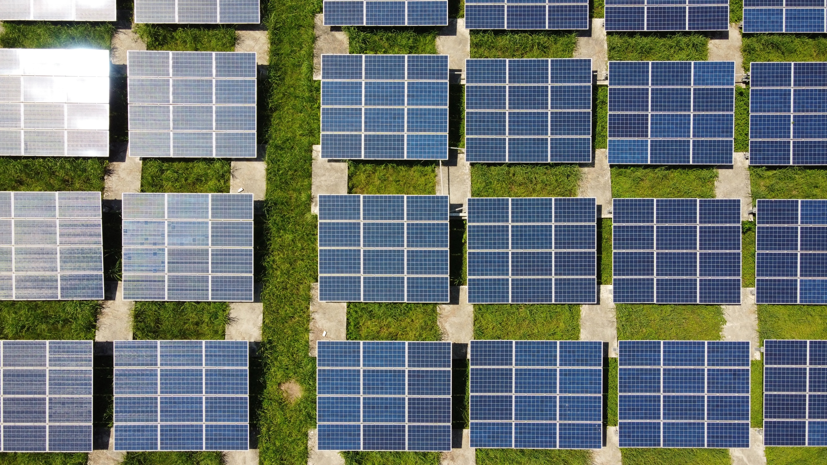
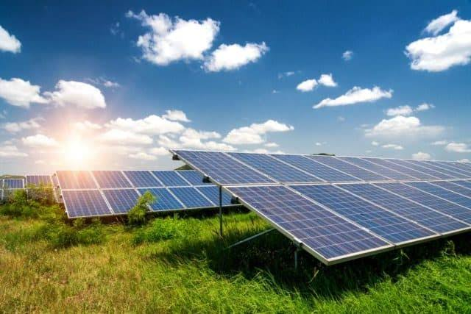
Content
Introduction
Literature review
Problem identification
Proposed method for the problem solution
Progress of the work
Reference

Slide 3
Introduction
This is a solar tracking system which can be used as a power generating method from sunlight .
This method of power generating is simple and is taken from natural resource.
It converts Photovoltaic energy in to electrical energy. This Project helps for Power generation by setting the equipment to get maximum sunlight automatically.
This system tracks maximum amount of energy from sun thereby increasing the efficiency when compared to Fixed Solar Panel.

Slide 4
Literature review
Nader Barroom [2010], Global Journal on Technology, states that research has proved that solar tracking system with single axis freedom can increase energy output by approx. 40 % when compared to that of solar panels that are fixed in certain position.Therefore this work was to develop and implement a solar tracking system with this degree of freedom and which detects the sunlight using sensors.
A US patent No. 0293861 by William F Taylor [2009] describes a conventional solar tracker employing controllable movable solar panels to expose them continuously to the path of the sun both throughout the day and throughout the year.

Slide 5
Problem identified
Solar energy is the most reliable and renewable source of energy.
It converts the energy from sun in to electrical or thermal energy.
Since most of the solar panels are in fixed position, we are not able to receive the energy from the varied positions of the sun(As we know that sun moves from east to west).So it is clear that efficiency of solar energy is very low.
Since we are getting most of the energy from the midnoon times Therefore we have come up with a solution to implement SINGLE AXIS SOLAR TRACKING SYSTEM.

Slide 6
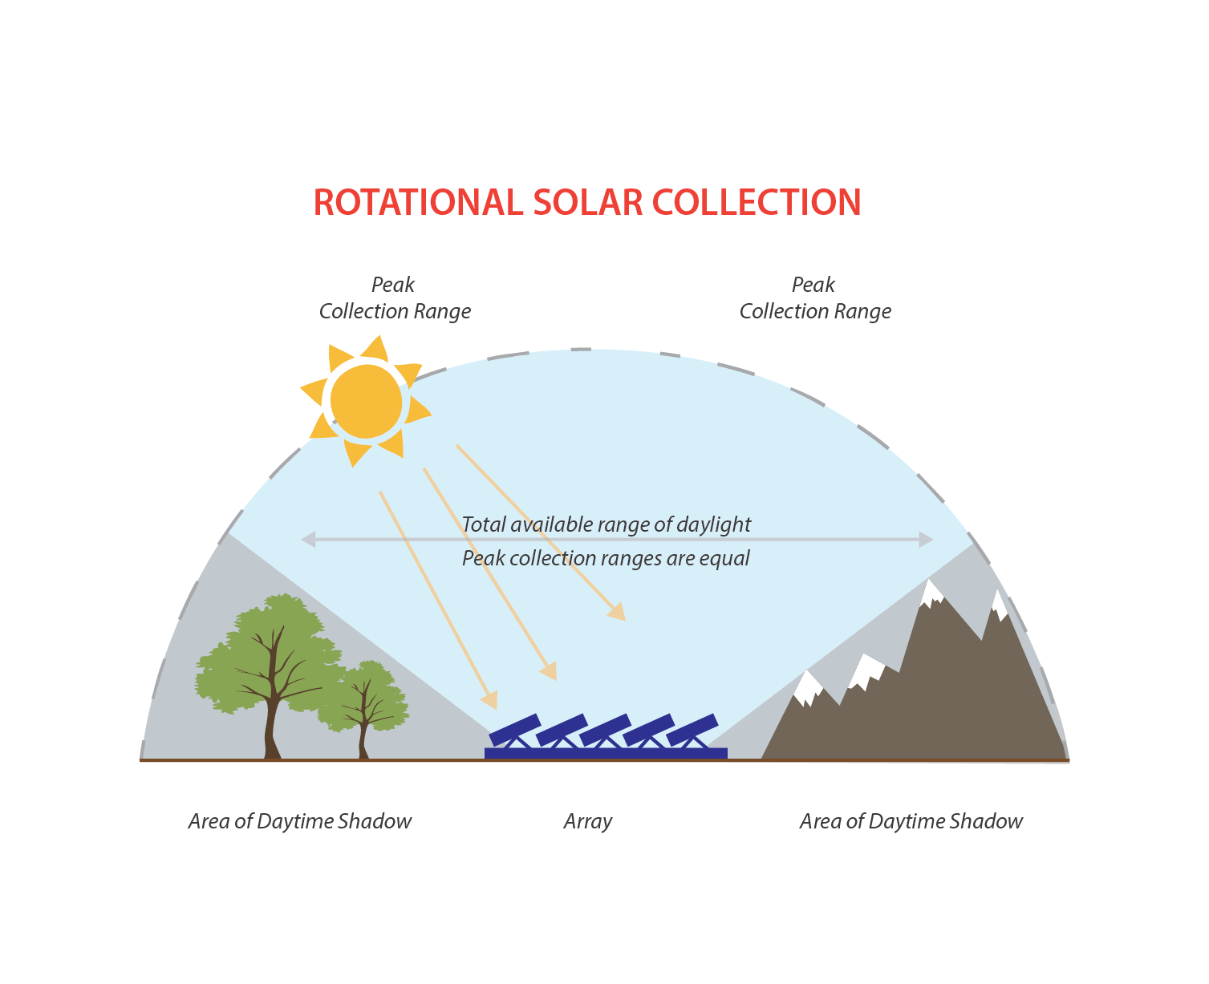
SINGLE AXIS SOLAR TRACKER

Slide 7
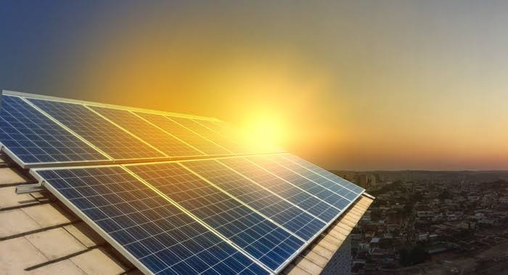
Proposed solution for the problem
Solar trackers can increase energy production by up to a third or more versus a fixed system.
This means that more energy can be produced without needing to increase the size of the system, making for smarter use of land.
A solar tracking system adjusts the position of a solar panel along an axis. This is done to ensure a small angle of incidence or the angle that sunlight hits a solar panel.
Since the energy output of a solar system increases as the angle of incidence decreases, keeping this angle as small as possible is ideal.

Slide 8
SINGLE AXIS SOLAR TRACKER
Single axis is just a system that follows the sunlight by using this system you can make more power collected through the sunlight by the solar system.
This system has a solar panel on it, all the systems track the light in two directions. for example, if the sun rises in the morning the system moves toward the same direction and for the evening also.
Now the sunset is in the opposite direction so the system will also move with the sun so the system can get the maximum power by the sun tracking.
In solar panels make more power to more intensity. that means the solar power converted to electricity is directly proportional to the intensity of light.

Slide 9

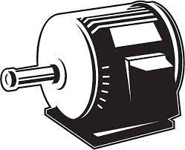
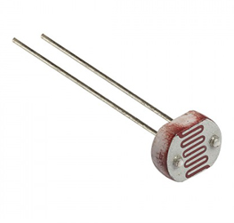
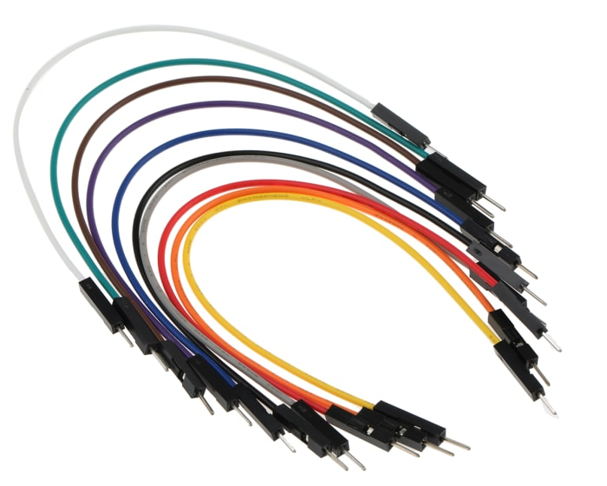
Components needed
Arduino Uno
2 LDR
10K Ohm Resistor
Servo Motor
Solar Panel
Jumper wire
Breadboard

Slide 10
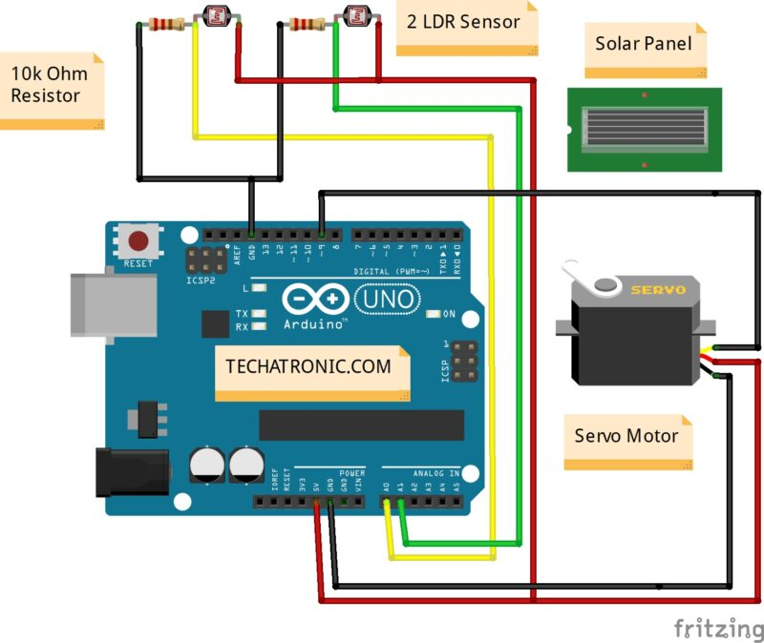
Circuit diagram for Single Axis Solar Tracker

Slide 11
Working of Single Axis Solar Tracker
There is a sensor called LDR (light-dependent resistor) which decreases the resistance in the circuit when the light incident on it.
There are two LDR in the circuit on both sides.
So, which LDR shows the less resistance the motor will start to move in that direction.
LDR gives output to the Arduino every time. and Arduino process the data comes from the LDR and Sends instructions to the Servo motors.

Slide 12


Slide 13
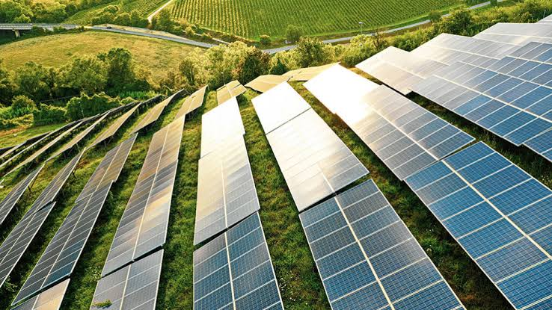
Advantages
More reliable
Inexpensive
More efficiency
More power generation
Eco-Friendly
Longer life span
Portable

Slide 14
Disadvantages
Climate dependent
Fewer technology advancements
The machinery complexity is slightly high in automatic solar trackers
High Maintenance cost

Slide 15
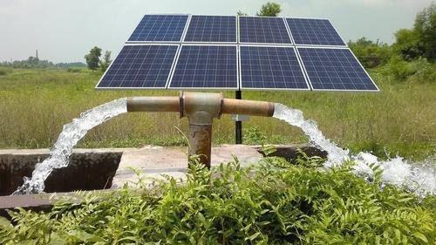
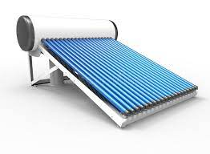
Applications
Solar water heating
Solar pumping
Solar electric power generation
Solar furnaces
Solar ventilation
Solar lighting

Slide 16
Conclusion
The solar tracker will help in future to make bigger systems which can be chronologically operated and helped in efficient tracking the position of the sun. Finally we can say that implementation of this model on large scale will ensure that bigger models can be implemented using better and bigger motors.

Slide 17
Progress of the work
Till now, we have succeeded to gather all the information related to the project – “SINGLE AXIS SOLAR TRACKING SYSTEM”.
Here, the equipment were connected with the help of pcb
Hence, the system was successfully designed and implemented and results were checked.

Slide 18
References
A.K Saxena and V. Dutta , “A versatile microprocessor based controller for solar tracking in proc IEEE 1990.
Ramaprabha , R., Gothandaraman , K.Divya, B.L.Maximum power pointtracking using GA optimized artificial neural network for Solar PV system, Electrical Energy systems(ICEES), 2011 1st International Conference on, 3-5 Jan 2011.
Techatronic https://techatronic.com/single-axis-solar-tracker-project-tutorial//
Aryuanto Soetedjo. Modeling of Maximum Power Point Tracking Controller for Solar Power System.
Yuhong Zhao, Xuecheng Zhao, Yunhui Zhang. MPPT for Photovoltaic System Using Multi-objective

Slide 19
THANK YOU
😊

